Slide 1


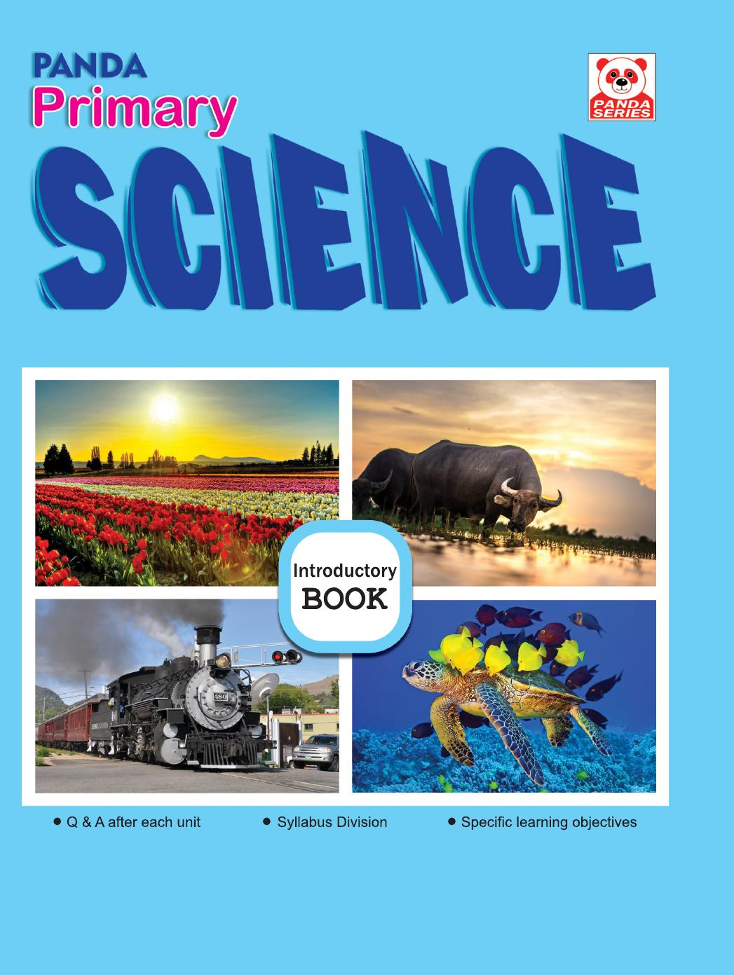
Panda Primary Science
Introductory • Age 4+
An activity-based early-years book from the Panda Series.
A Project of Azhar Publishers & Book Factory

Slide 2
i
What's Inside
Panda Primary Science Introductory • Age 4+
1
First science topics with big pictures
2
Living and non-living things
3
Our body and our senses
4
Plants, animals and food
5
Air, water and weather
6
Questions & answers after each unit

Slide 3
★
Purpose & Classroom Support
Sparks curiosity about the world with simple science concepts, clear pictures and easy questions and answers.
“
Every book comes with
1
2
3
Teacher's Lesson Plan
Practice Papers
Digital Interactive Version
A 40-week lesson plan that guides teachers, day by day.
Monthly tests and term exam papers for children to attempt.
An interactive flipbook and digital exercises for engaging, screen-based practice.
A Project of Azhar Publishers & Book Factory

